Slide 1

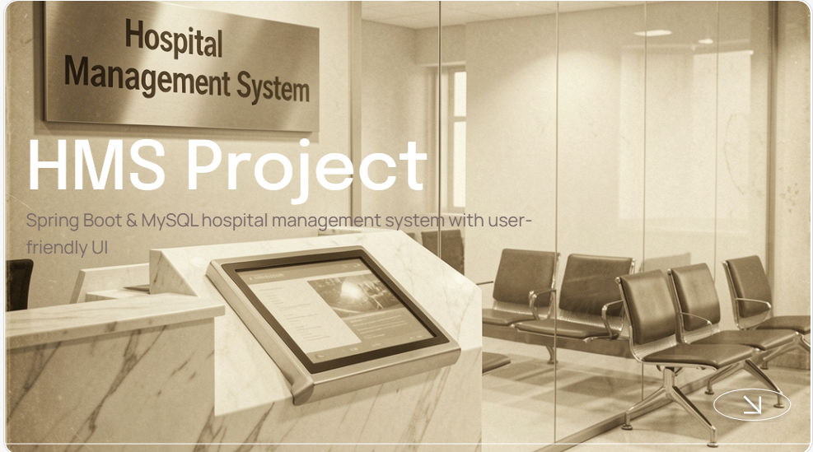
HMS Project
Spring Boot & MySQL hospital management system with user-friendly UI

Slide 2

Introduction
The Hospital Management System (HMS) is a web-based application developed to automate and simplify the daily operations of hospitals and healthcare organizations. It provides a centralized platform for managing patient records, doctor information, appointments, billing, pharmacy, and medical reports efficiently.
The system is developed using Spring Boot for the backend, MySQL (SQL) for database management, and React.js for the frontend. It uses Spring Data JPA (Hibernate) for database operations, Spring Security for secure authentication and authorization, and REST APIs for seamless communication between the frontend and backend.

Slide 3

01
System Overview
A web-based system that efficiently manages hospital operations, patient records, appointments, and billing in one secure platform.

Slide 4

Features
Core modules: patient management, doctor profiles, appointments, medical records, pharmacy, and billing.
Designed for efficiency with Appointments scheduling, Billing automation, role-based access, and audit-ready record keeping.

Slide 5
Architecture
Layered Design: Presentation, Service, and Data layers for a modular and scalable system.
REST APIs: Connect the frontend and backend for seamless communication.
Spring Data JPA: Handles database operations with MySQL.
Spring Security: Provides secure authentication and authorization.
Deployment: Runs as a Spring Boot application and supports Docker-based deployment.

Slide 6
Tech Stack
The app uses :
Spring Boot for backend,
MySQL for data storage, and
React.js for a responsive frontend.
Deployment options: containerized with Docker, optional CI/CD. Designed for scalability and easy maintenance with Spring Data JPA and REST APIs.

Slide 7

02
Implementation Details

Slide 8
Backend (Spring Boot)
Business Logic: Services handle the main application logic and process user requests.
REST Controllers: Controllers expose REST APIs to connect the frontend with the backend.
DTOs: Data Transfer Objects (DTOs) safely transfer data between different layers.
Database: Spring Data JPA simplifies database operations with MySQL.
Security: Spring Security provides secure login and role-based access.
Layered Structure: Separates the code into different layers, making the application easy to maintain, test, and scale.

Slide 9
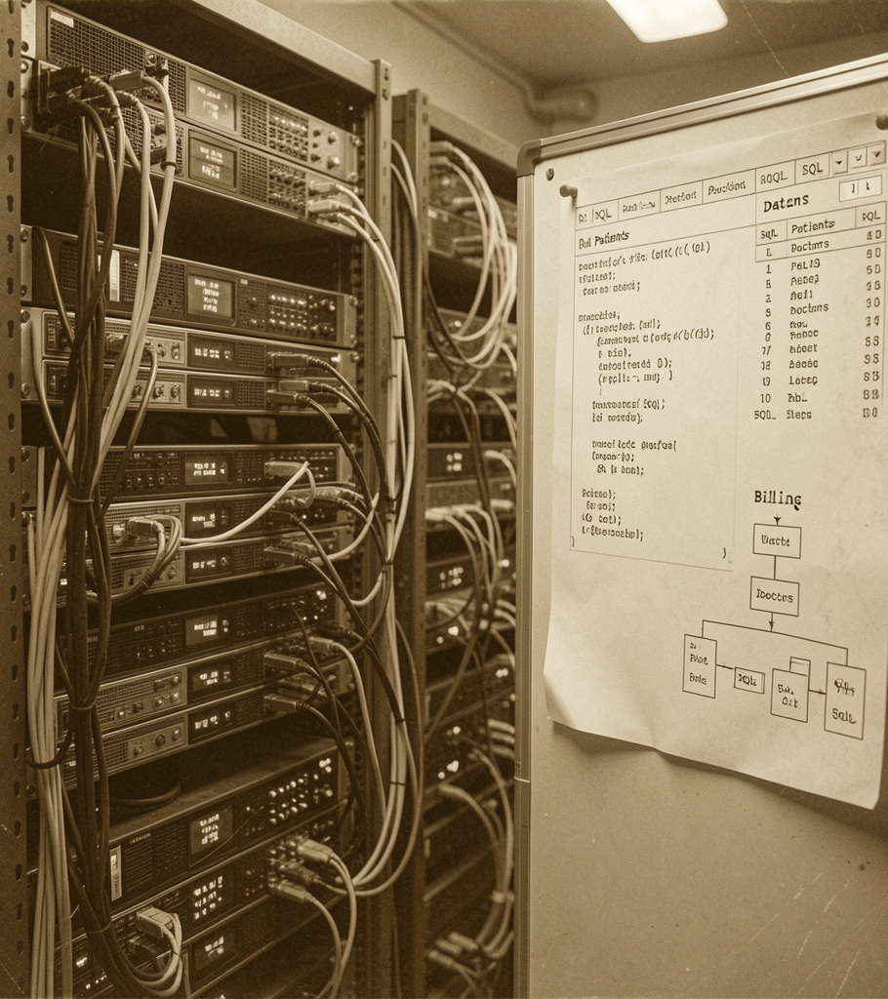
Database (MySQL & JPA)
Relational schema with tables for patients, doctors, appointments, records, billing, and pharmacy.
Uses JPA/Hibernate for ORM, migrations via Flyway/Liquibase, and optimized queries with indexes for performance.

Slide 10
Frontend & Security
Responsive Design: Built with React.js for a user-friendly interface.
Easy Navigation: Simple pages help users access features quickly.
Role-Based Access: Different dashboards are provided for Admin, Doctor, and Patient.
Secure Login: JWT or session-based authentication protects user accounts.
Input Validation: Checks user input to reduce errors and improve data accuracy.
Secure Communication: HTTPS keeps data safe while communicating with the server

Slide 11
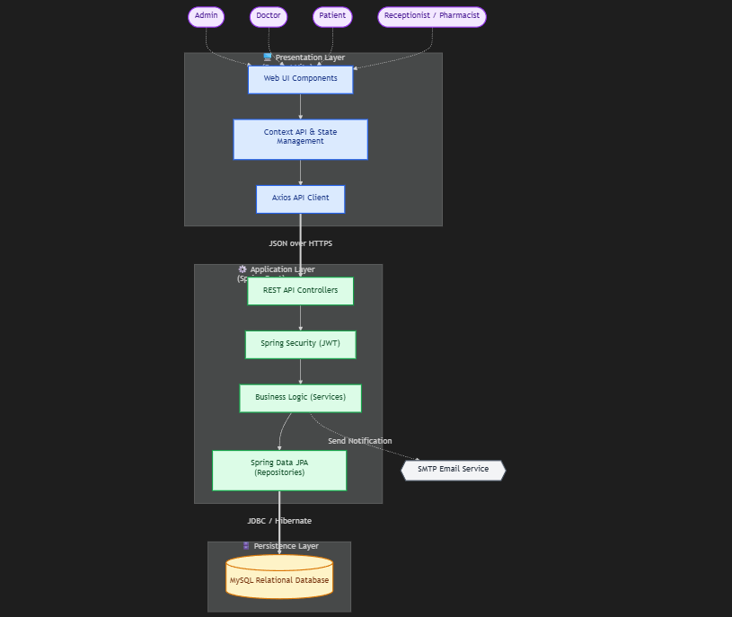
Data flow

Slide 12
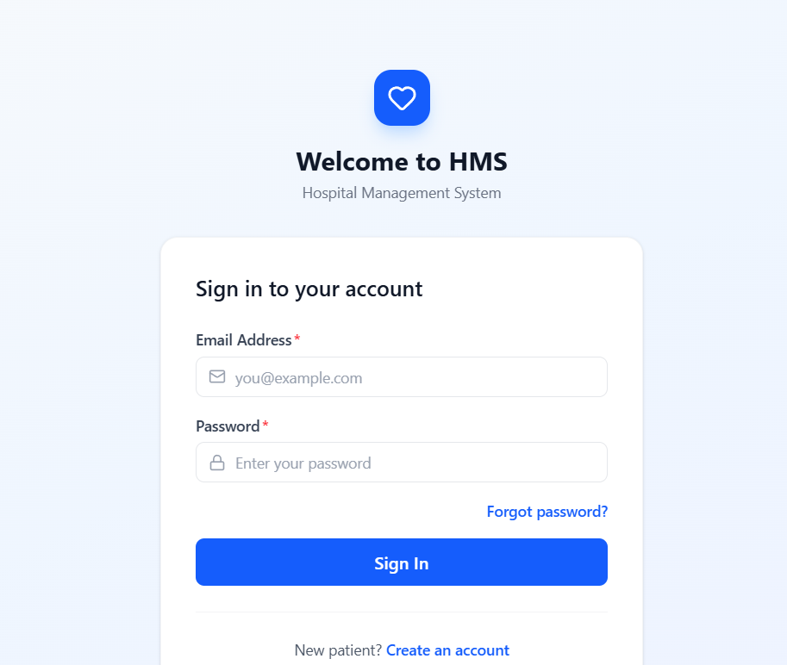
Screenshots
Sigin page

Slide 13
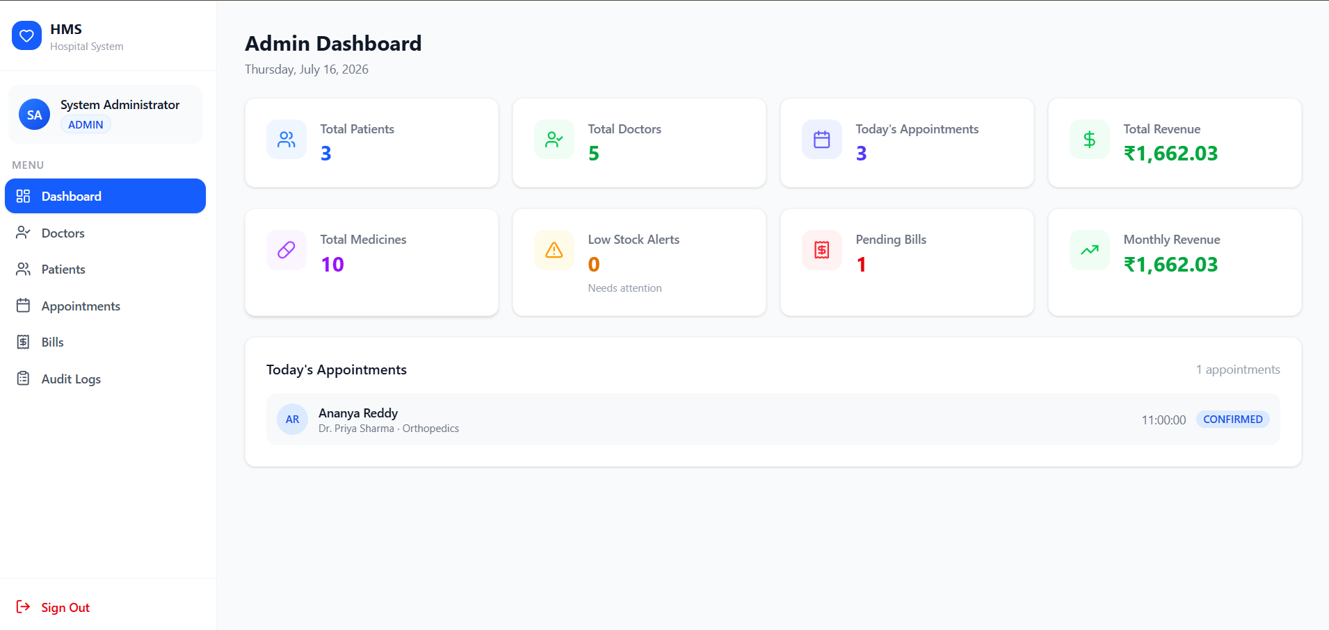
Screenshots
Admin Dashboard

Slide 14
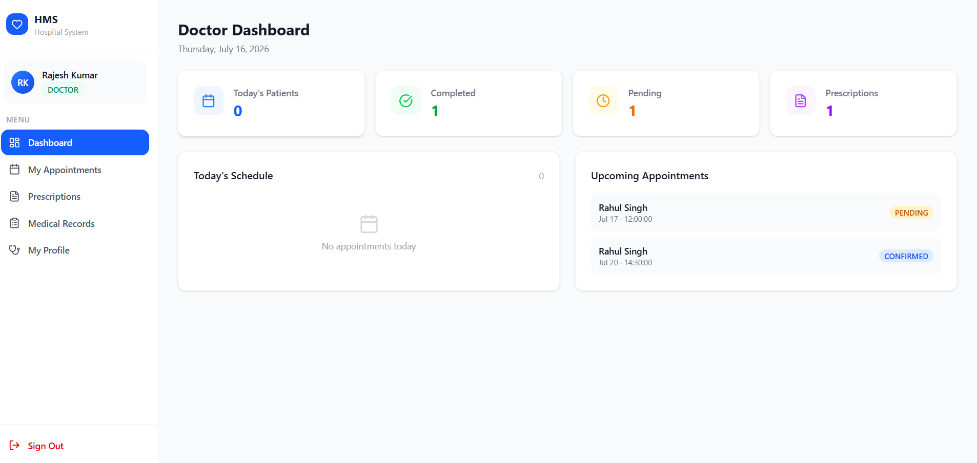
Screenshots
Doctor Dashboard

Slide 15
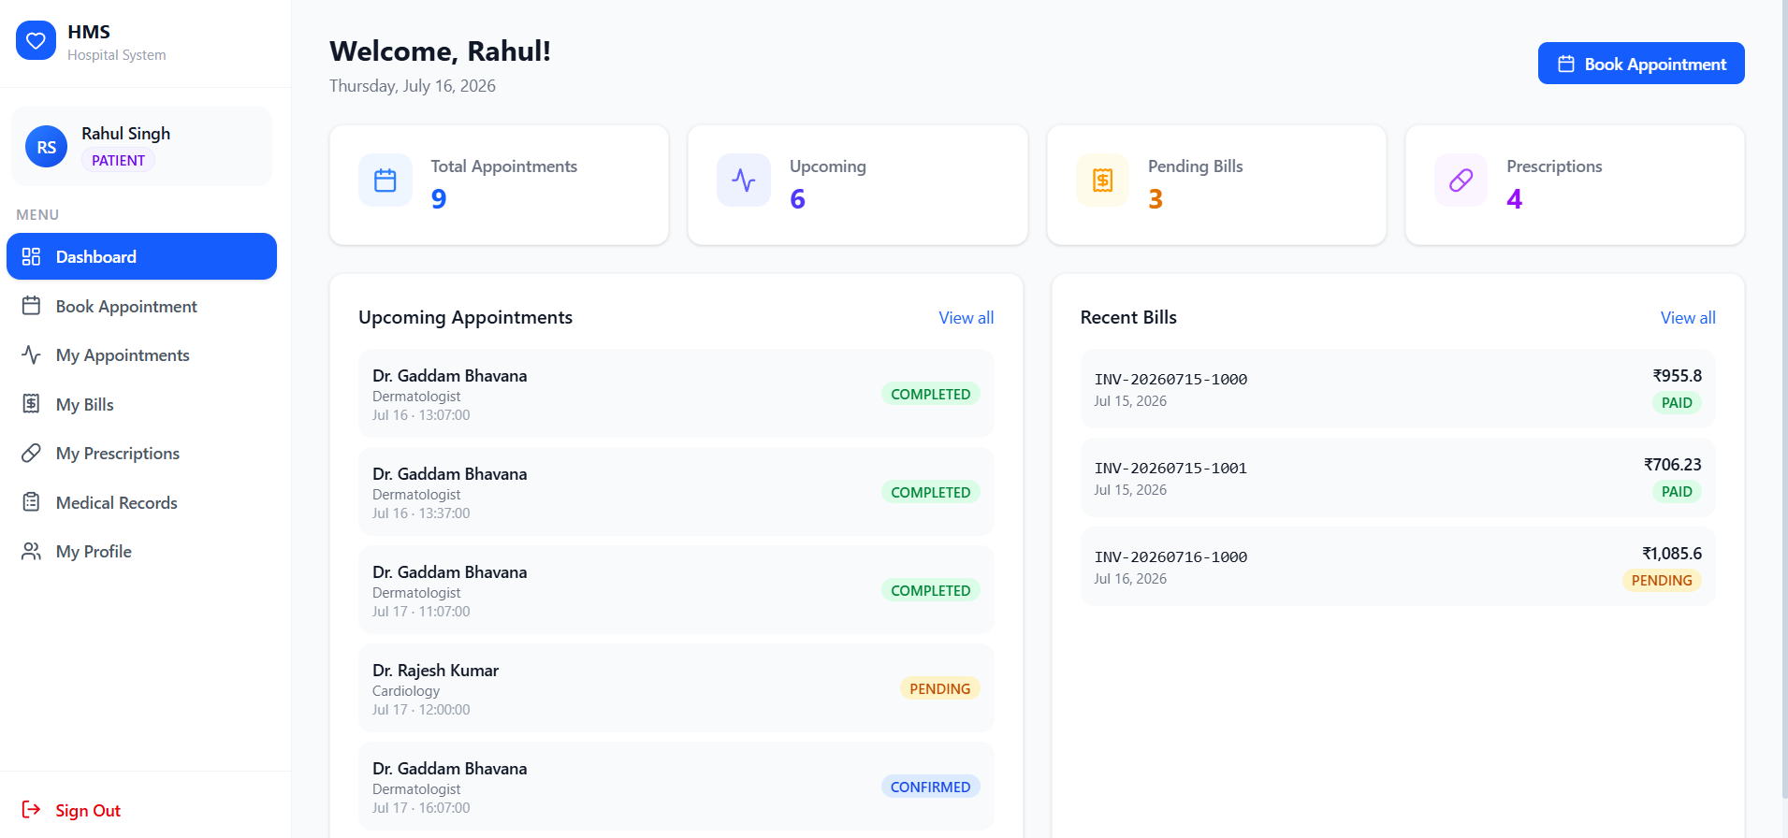
Screenshots
Patient Dashboard

Slide 16
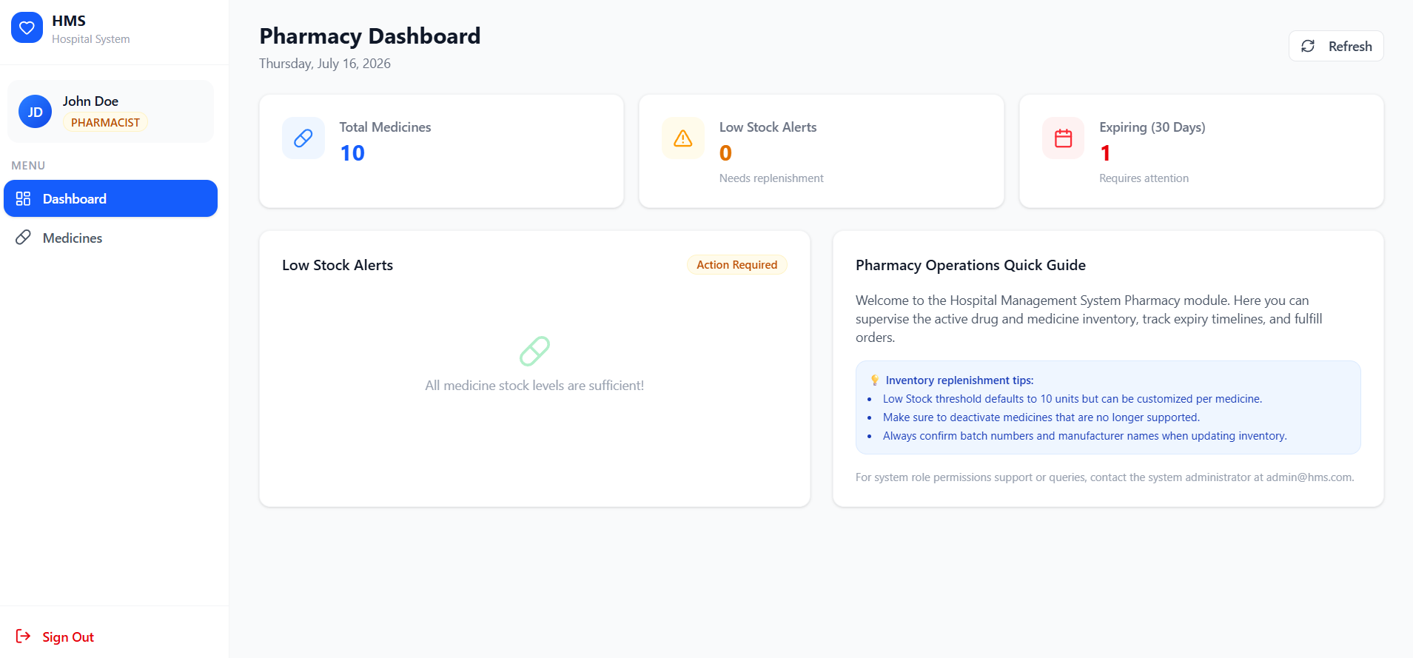
Screenshots
Pharmacy Dashboard

Slide 17
Conclusion
In conclusion, the meticulous development and successful implementation of this comprehensive, web-based Hospital Management System represent a significant and necessary technological leap forward in the administration and delivery of healthcare services. By deeply analyzing the critical flaws, bottlenecks, and inherent inefficiencies of traditional, manual record-keeping systems, this project successfully engineered a robust, digital solution that elegantly addresses the complex, multifaceted needs of modern medical facilities.
The strategic utilization of a robust and highly scalable technology stack—comprising React.js for an exceptionally intuitive, responsive user interface, Spring Boot for powerful, secure backend processing, and MongoDB for highly flexible, high-performance data management—has proven to be highly effective and architecturally sound. The system successfully and seamlessly integrates crucial hospital modules, facilitating instantaneous communication and flawless data flow between administrators, medical professionals, and pharmacy staff.

